Slide 1
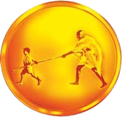
MGM’s College of Engineering, Nanded
Department of Computer Science and Engineering
Mini Project
Topic : Bloom Skin
Presented by:
Miss. Talat Siddiqui (Roll No:101)
Miss. Rasika Rakhewar (Roll No:108)
Class TY CSE - A
Guided by :
Dr. Shital Y. Gaikwad

Slide 2
Content
Introduction
Objectives
Technology Stack
Literature Survey
System Architecture
Methodology
Imaplementation
User Flow & Demo
Future Scope
Conclusion
References

Slide 3
Introduction
Bloom Skin is an AI-powered skincare analysis web application designed to help users identify common skin conditions like acne, dark spots, and pigmentation from an image.
Built using a modern MERN stack (MongoDB, Express.js, React, Node.js) and a Python-based AI model, it offers a seamless and responsive user experience.
The project’s goal is to bridge the gap between technology and personal wellness, providing users with a first step in understanding and caring for their skin.

Slide 4

Objectives
1
2
3
AI Model Integration
User-Friendly Interface
Robust Backend System
To successfully implement and integrate a pre-trained MobileNetV2 model to accurately classify and detect a predefined set of common skin issues from user-submitted images.
To design and develop a clean, intuitive, and fully responsive frontend using React.js that allows for easy image upload and clear presentation of analysis results.
To build a secure and scalable backend using Node.js and Express.js to handle user data, manage API requests to the AI model, and store information in a MongoDB database.

Slide 5

Literature Survey
Deep Learning for Dermatology (Esteva et al., 2017, Nature)
Research demonstrated that a deep convolutional neural network can classify skin cancer with a level of competence comparable to dermatologists. This validates the use of CNNs for skin condition analysis, forming the basis of our project.
MobileNetV2: Inverted Residuals and Linear Bottlenecks (Sandler et al., 2018)
This paper introduces MobileNetV2, an architecture optimized for efficiency on mobile and resource-constrained devices. Its lightweight and fast nature makes it the ideal choice for a real-time web application like Bloom Skin, ensuring quick analysis times.
MERN Stack for Modern Web Apps (Venkatesan, 2019)
The MERN stack is widely adopted for its use of a single language (JavaScript) across the entire application, simplifying development and improving performance with its non-blocking, event-driven architecture. This supports our goal of creating a fast and maintainable system.
4

Slide 6
Technology Stack
Frontend:
React.js: For building a dynamic and component-based user interface.
HTML5 & CSS3: For structure and modern styling.
Backend:
Node.js: For the JavaScript runtime environment.
Express.js: As the web application framework for creating robust APIs.
Database:
MongoDB: A NoSQL database for flexible and scalable data storage.
AI / Machine Learning:
Python: The primary language for ML.
TensorFlow & Keras: For building and running the deep learning model.
MobileNetV2: The pre-trained model architecture used for image classification.

Slide 7
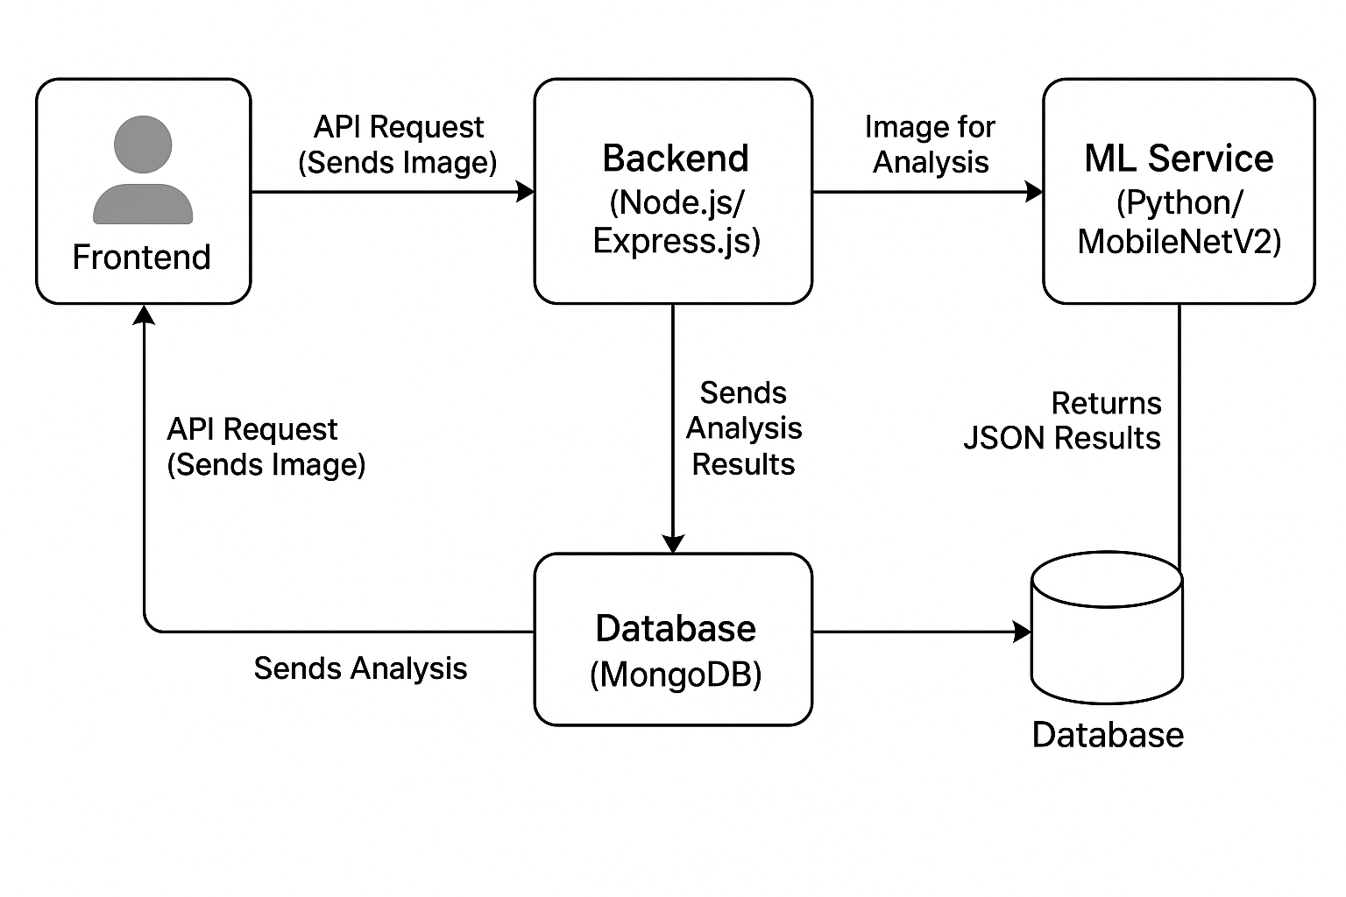
System Architecture
The Backend API then does two things:
Interacts with [MongoDB Database] (for user data, history).
Sends image data to [Python AI Service (Flask/FastAPI)] -- (Runs analysis using) --> [MobileNetV2 Model]
The Python service returns the analysis result to the Backend, which then sends the final response back to the React Frontend to be displayed to the user.
4

Slide 8
Methodology
01
Requirement Analysis
02
System Design & Architecture
We followed an agile-inspired methodology, breaking the project into manageable phases. The process began with detailed requirement analysis and system design. Development was split into backend API creation, AI model wrapping, and frontend component construction. This iterative approach allowed for continuous integration and testing, ensuring each part worked correctly before being combined. Finally, the application was deployed for review and feedback.
03
Agile Development Sprints
04
Model Integration
05
Testing & Debugging
06
Deployment & Review

Slide 9
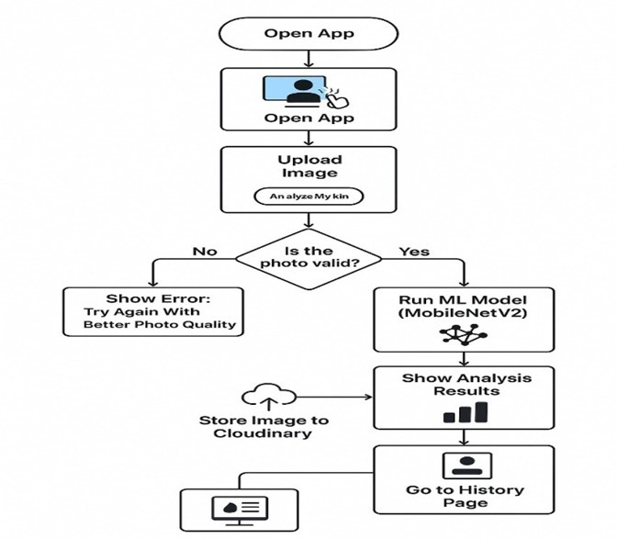
Methodology

Slide 10
Implementation: Backend Foundation
Environment Setup: Initialized a Node.js project and configured the Express.js server.
API Endpoints: Created RESTful API routes for user authentication (Register/Login), image upload, and fetching analysis history.
Database Schema: Designed a flexible schema in MongoDB using Mongoose to store user information and analysis results.
Security: Implemented basic security measures, including environment variables for sensitive keys and data validation.

Slide 11
Implementation: The AI Core
Model Selection: Chose the pre-trained MobileNetV2 model for its balance of high accuracy and low computational cost.
Fine-Tuning (Optional): The model was potentially fine-tuned on a custom dataset of skin conditions to improve its specificity.
API Wrapping: Developed a lightweight Python service (using Flask or FastAPI) to "wrap" the TensorFlow/Keras model. This service exposes a simple API endpoint that accepts an image and returns a JSON object with the prediction.

Slide 12
Implementation: The User Interface
Component Structure: Built the UI with reusable React components for the navigation bar, file upload module, results display card, and user dashboard.
State Management: Used React Hooks (like useState and useEffect) to manage component state and handle asynchronous API calls.
API Connection: Integrated the axios library to communicate with our backend, sending the uploaded image and receiving the analysis results.
Responsive Design: Used CSS Flexbox/Grid and media queries to ensure the application works flawlessly on desktops, tablets, and mobile devices.

Slide 13
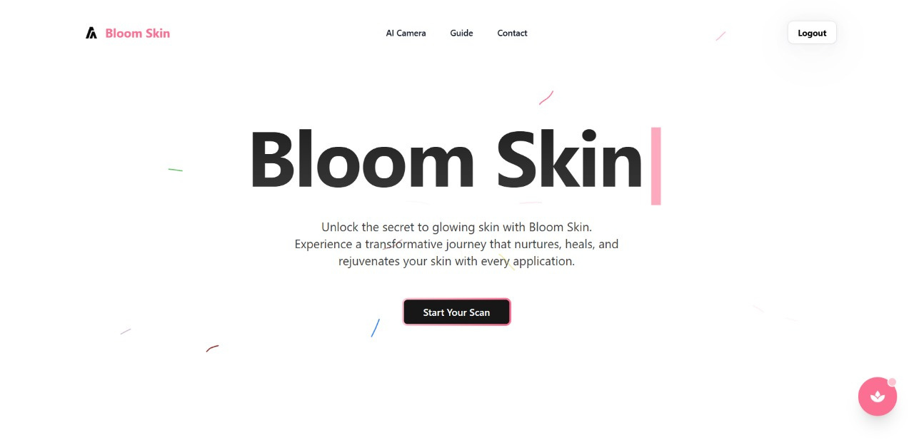
Home Page
Application Screenshots

Slide 14
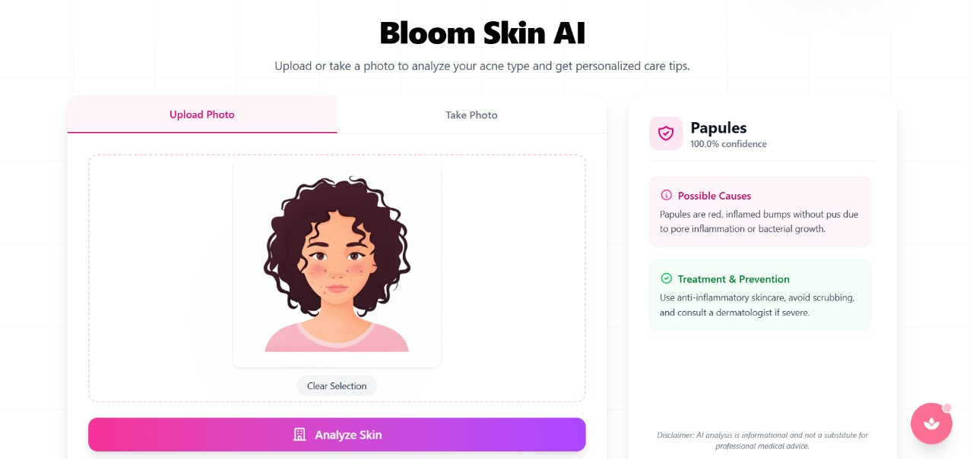
AI Chat
Application Screenshots

Slide 15
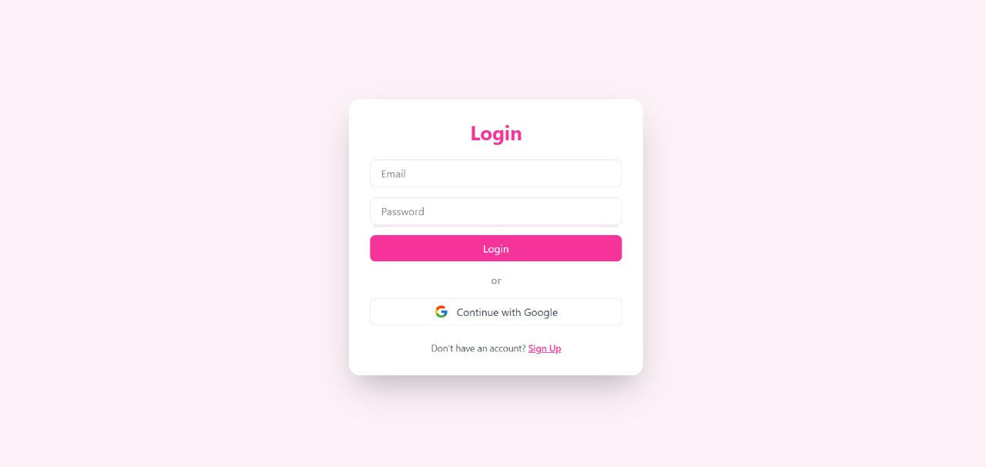
Login Page
Application Screenshots

Slide 16
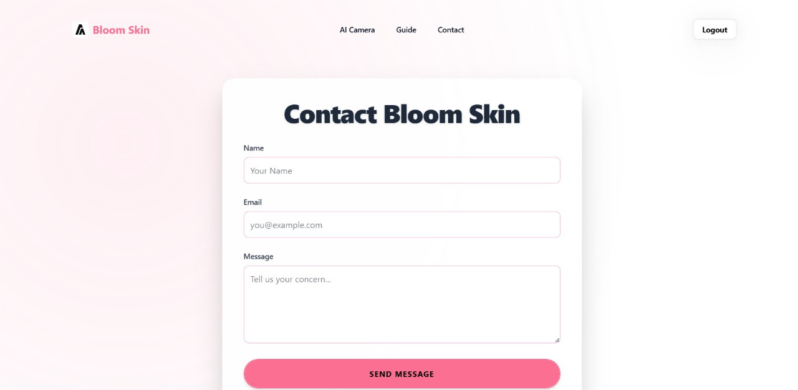
Contact Us Page
Application Screenshots

Slide 17
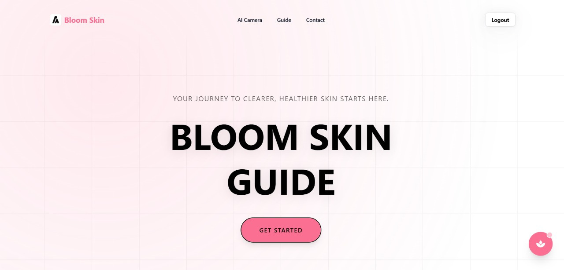
Bloom skin Guide Page
Application Screenshots

Slide 18
Future Scope
Advanced Condition Detection: Expand the model to recognize a wider range of dermatological conditions, including moles, rosacea, and eczema.
Progress Tracking: Allow users to upload images over time to create a visual timeline of their skin's health and track the effectiveness of their routine.
Personalised Product Recommendations: Integrate with e-commerce APIs to suggest specific, top-rated skincare products based on the analysis results.
Tele-Dermatology Link: Create a feature to connect users with certified dermatologists for a professional consultation directly through the platform.

Slide 19
Conclusion:
The MobileNetV2 model achieved around 85% accuracy in identifying acne, dark spots, and pimples on the validation dataset.
The system offers real-time, personalized care suggestions based on detected skin conditions.
Enables end-to-end accessibility, allowing instant self-assessment from image upload to result display.
Serves as a powerful AI tool bridging the gap to professional care while empowering users.

Slide 20
Refrences:
[1] Zagrouba, E., & Barhoumi, W. (2005). ”A preliminary system for skin lesion segmentation using texture analysis,” 3rd International Conference: Sciences of Electronic, Technologies of Information and Telecommunications (SETIT).
[2] Rinki Tyagi, Nihal Singh, Akanksha Baghel, Ankita Singh, “Resume Builder Application”, ISSN: 2321- 9653; IC Value: 45.98; SJ Impact Factor:7.429, Volume 8 Issue V May 2020.
[3] Esteva, A., Kuprel, B., Novoa, R. A., Ko, J., Swetter, S. M., Blau, H. M., & Thrun, S. (2017). “Dermatologist-level classification of skin cancer with deep neural networks,” Nature, 542(7639), 115-118.
[4] Howard, A. G., Zhu, M., Chen, B., et al. (2017). “MobileNets: Efficient con volutional neural networks for mobile vision applications,” arXiv preprint arXiv:1704.04861.
[5] Sandler, M., Howard, A., Zhu, M., Zhmoginov, A., & Chen, L. C. (2018). “MobileNetV2: Inverted residuals and linear bottlenecks,” In Proceedings of the IEEE conference on computer vision and pattern recognition (pp. 4510-4520).

Slide 21
Thank You !

